Slide 1
L.A.C.E Project
Joshua Burkhart
Ian Stavros

Slide 2
Overview
LACE
Comorbidities
Models
Results
Discussion
Questions

Slide 3
What is L.A.C.E?
Identifies ‘at risk’ patients for readmission or death within a 30 day discharge
L = Length of Stay
Includes admission and discharge
A = Acuity of Admission
Admitted via Emergency Department
C = Comorbidities
Weighted System based off of ICD 9 or 10
E = Emergency Department Visits
Number of times a patient visits an emergency department 6 months
prior to admission excluding the preceding visit

Slide 4
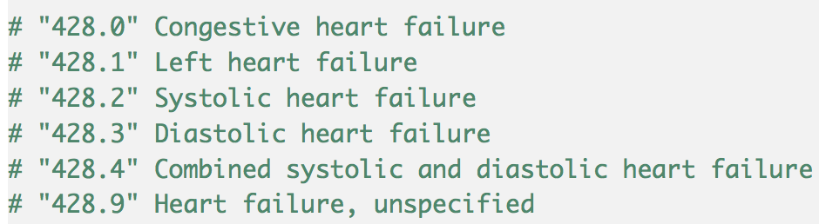
Comorbidity: CHF
Congestive Heart Failure (CHF)
~ 6 million Americans living with CHF
~ 100,000 people diagnosed yearly
~ 5% of UK Emergency admissions
~ 35% chance of death
within 1st year after diagnosis

Slide 5
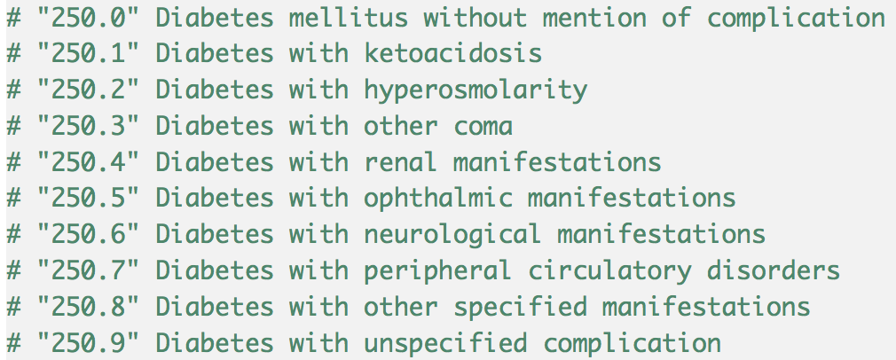
Comorbidity: Diabetes
Diabetes
~25 million Americans living with Diabetes
~1.5 to 5 million deaths, 2012 to 2015.
Global Economic Cost
~ $612 Billion
US Economic Cost
~ $245 Billion

Slide 6
Models
Linear Regression (glm)
Built-in linear model
https://stat.ethz.ch/R-manual/R-devel/library/stats/html/glm.html
Neural Net (nnet)
Single-layer neural net
https://cran.r-project.org/web/packages/nnet/index.html

Slide 7
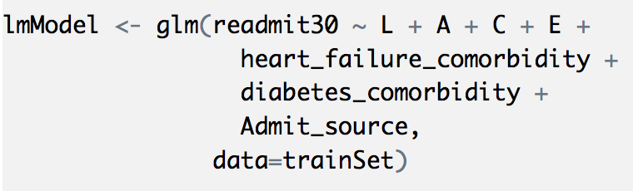
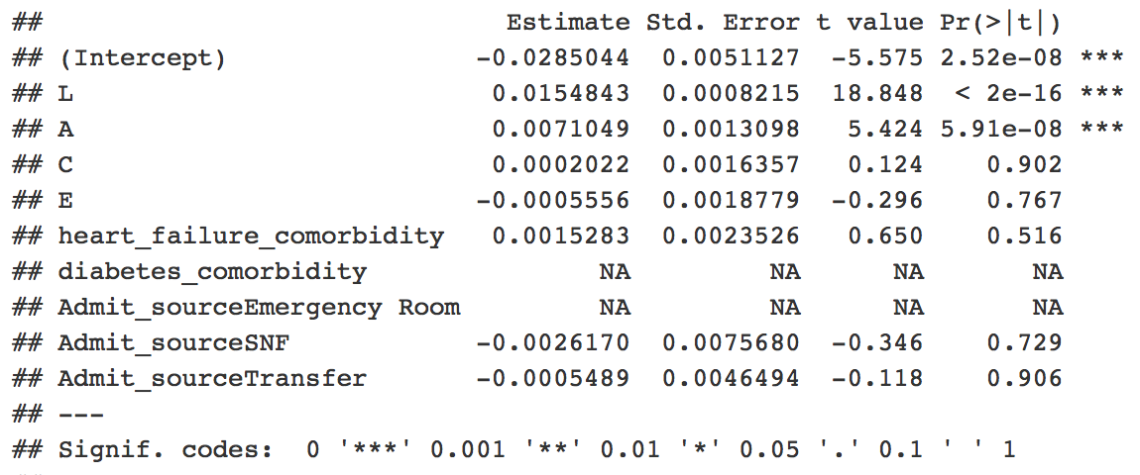
Model: glm

Slide 8
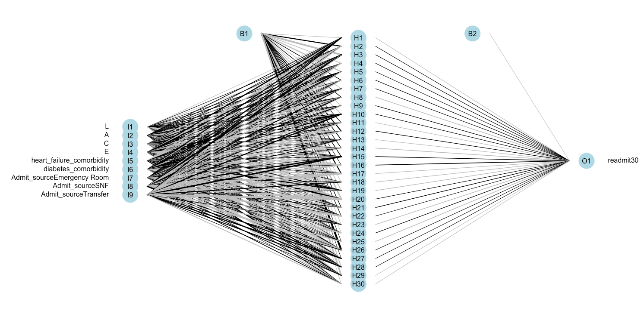
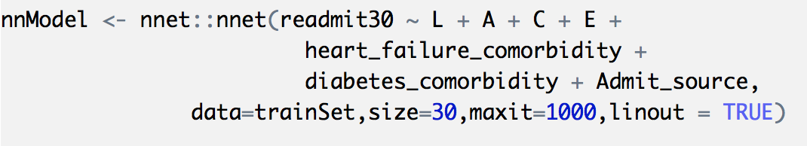
Model: nnet

Slide 9
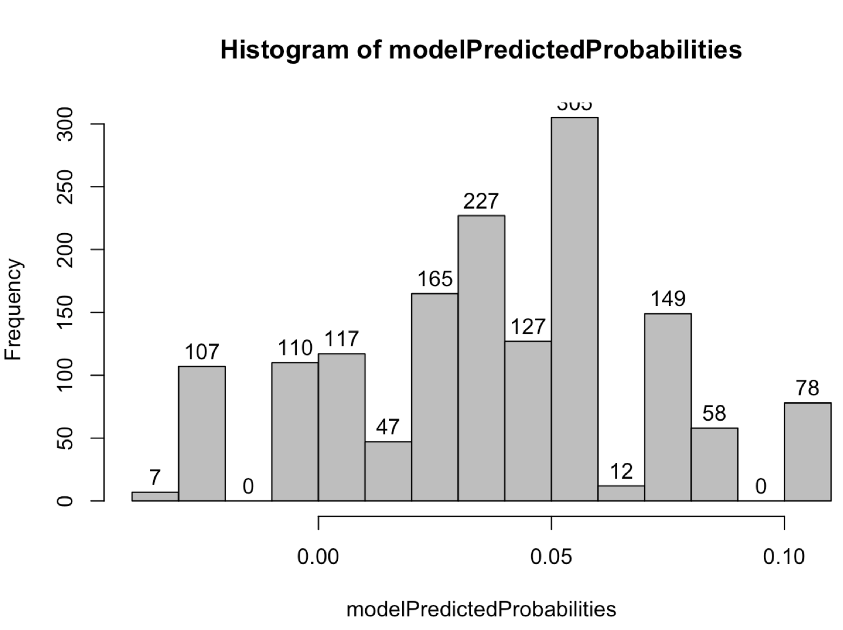
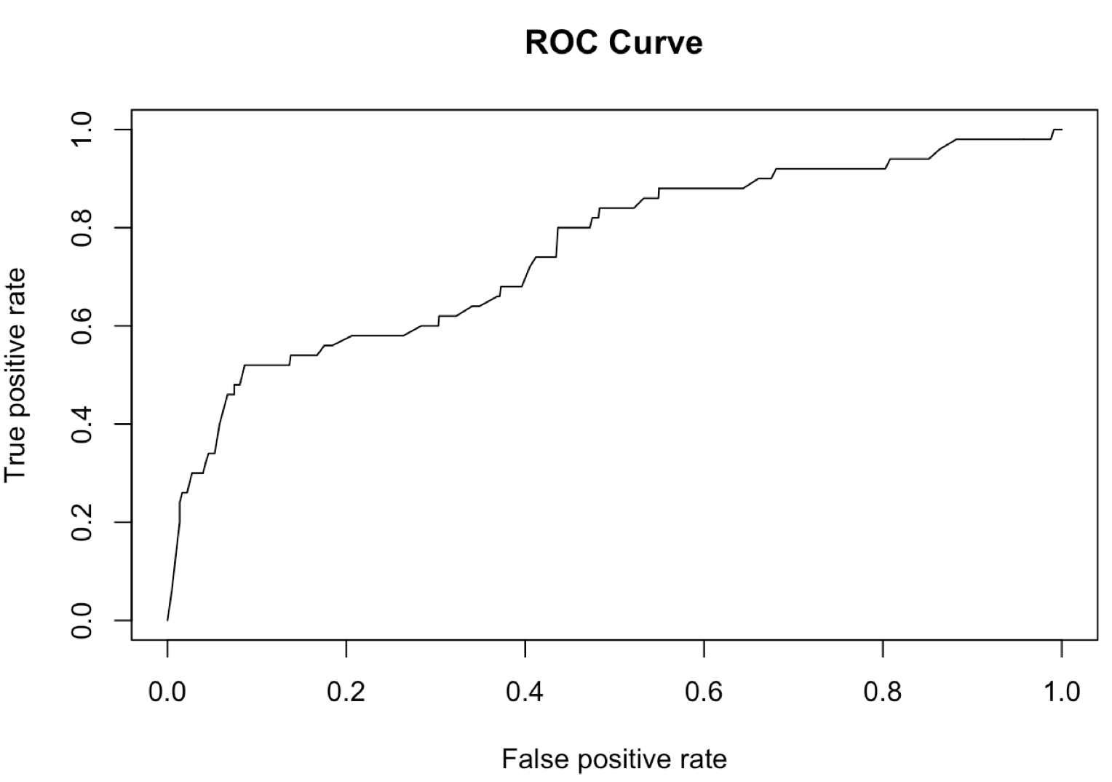
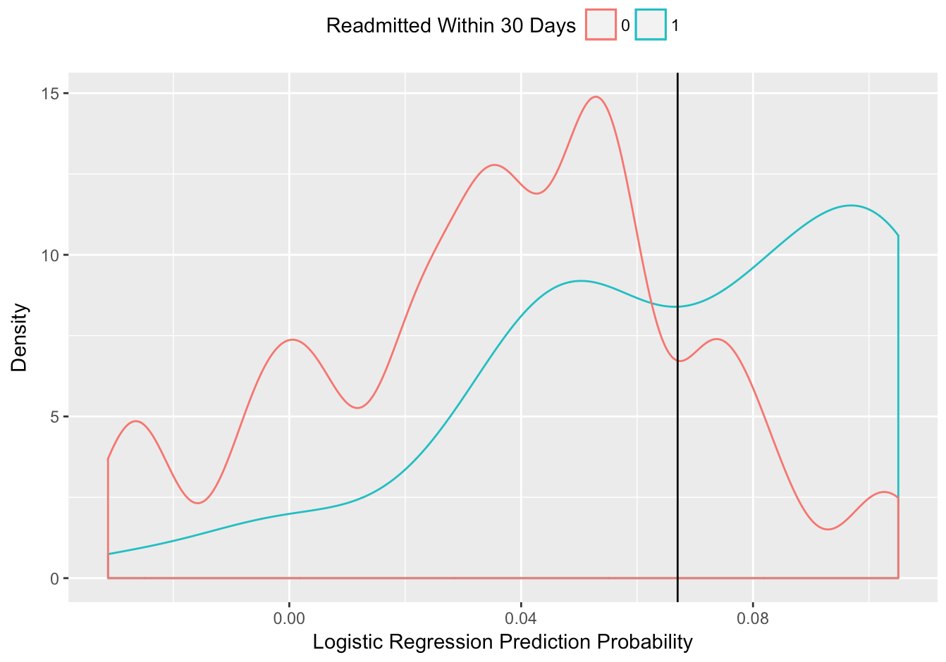
Results: glm
 | Predicted No Readmission | Predicted Readmission
No Readmission | 1397 | 62
Readmission | 34 | 16
Accuracy | 0.9363817
AUC | 0.7521385

Slide 10
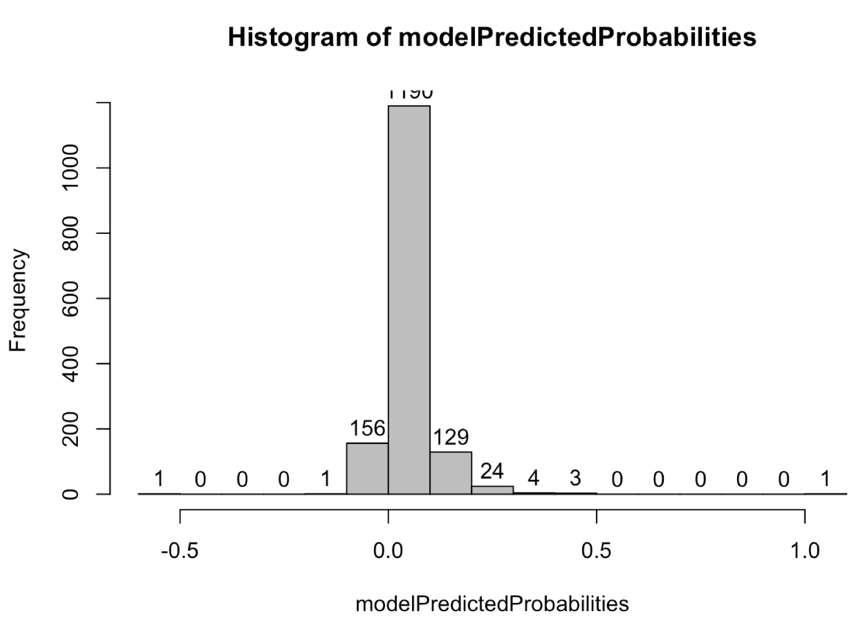
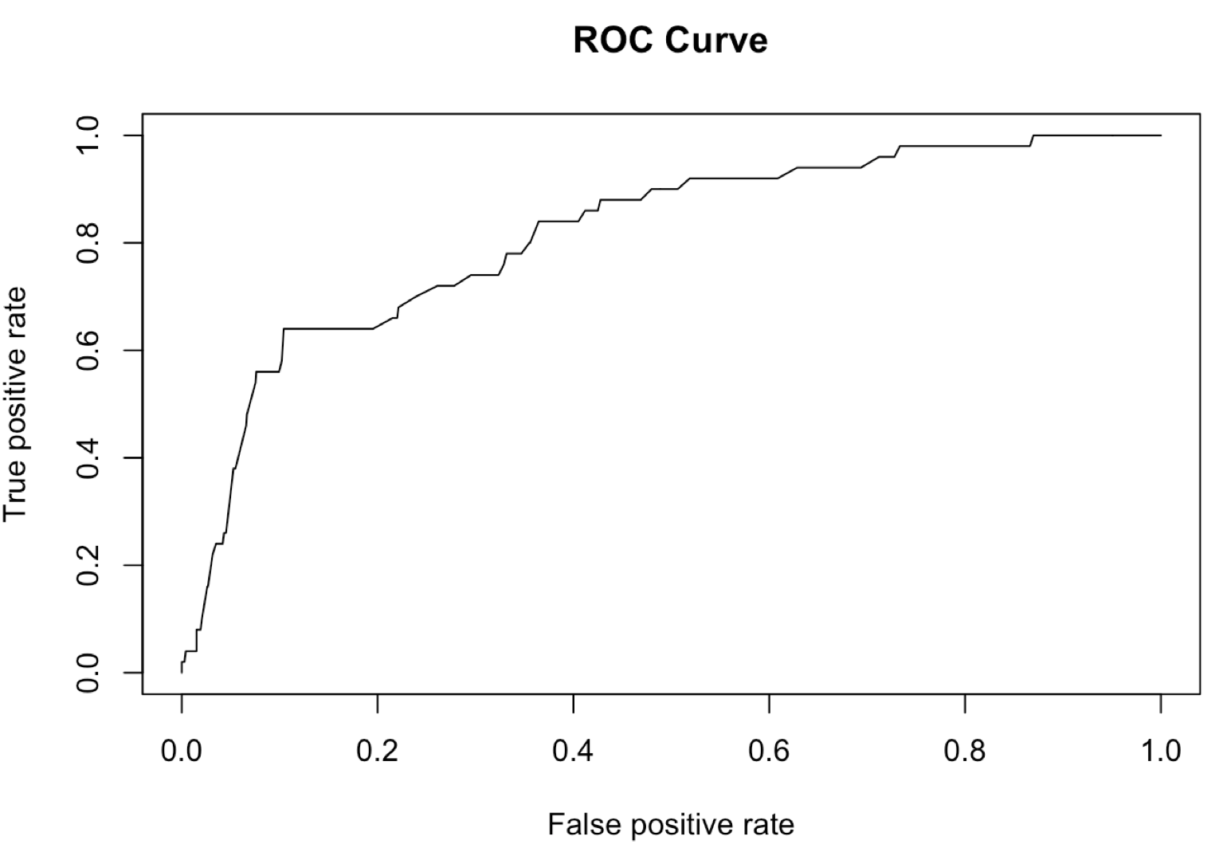
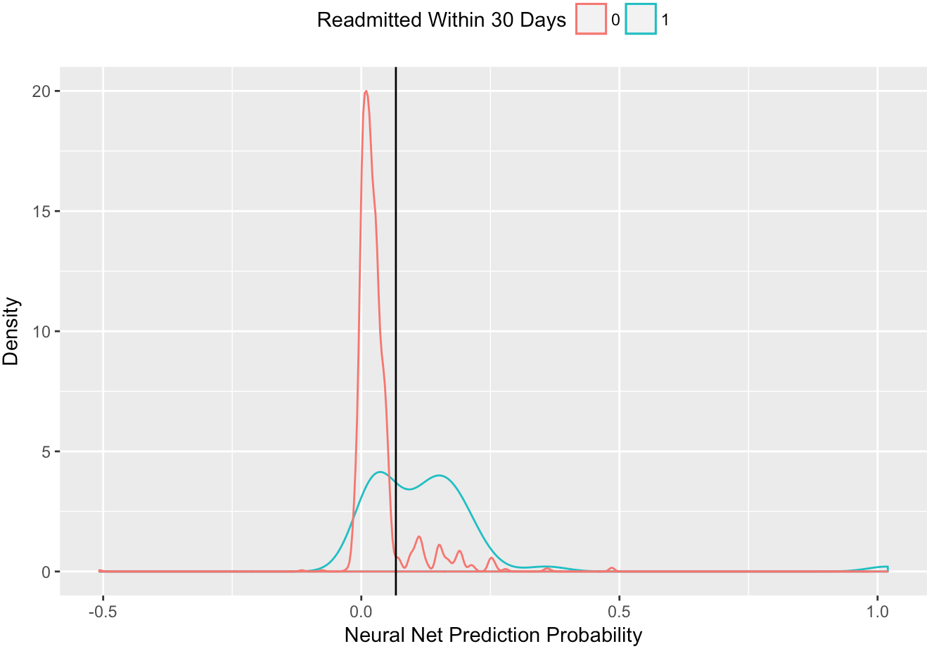
Results: nnet
 | Predicted No Readmission | Predicted Readmission
No Readmission | 1453 | 6
Readmission | 48 | 2
Accuracy | 0.9642147
AUC | 0.8150034

Slide 11
Discussion
 | glm | nnet
Accuracy | 0.9363817 | 0.9642147
AUC | 0.7521385 | 0.8150034
Sensitivity (proportion of positives that are correctly identified) | 0.09427609 | 0.1702128
Specificity (proportion of negatives that are correctly identified) | 0.9818482 | 0.986374
Positive Predictive Value (probability that positive prediction is positive) | 0.56 | 0.64
Negative Predictive Value (probability that negative prediction is negative) | 0.9243986 | 0.8965517

Slide 12
Questions & Listening

